Slide 1
Simple AI in Unity：
Mecanim, Action Lists, and more!
Jo Chung

Slide 2




Slide 3
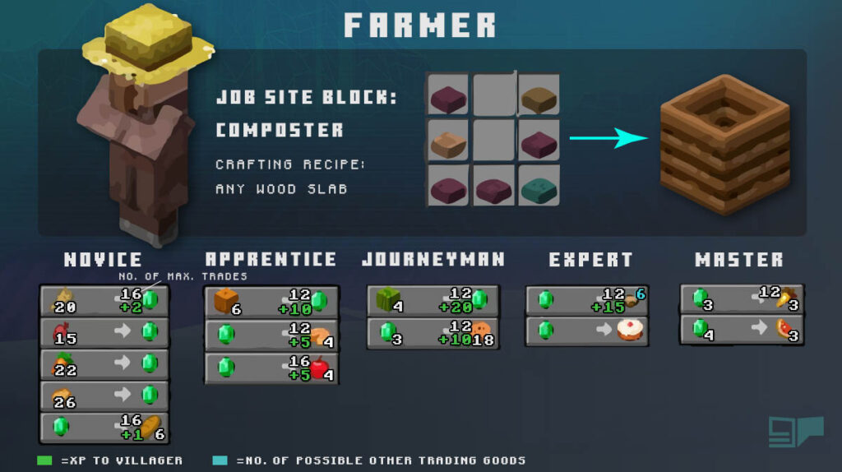
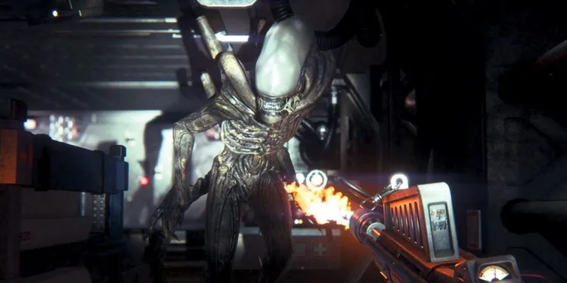

What can AI do in games?
NPCs
Attack
Follow
Navigation
Make decisions
Completing tasks
Develop relationships
Grow and learn (maybe)
Notes:
Minecraft villagers: different daily routine, pathfinding algorithm (A*, in later slides).
Alien: Isolation’s horror game, like the monster in Alex’s final project.

Slide 4
Overview
Behavior Trees
Action Lists
Mecanim State Machine
Unity StateMachineBehaviour component
demo
Pathfinding

Slide 5
Behaviour Trees

Slide 6
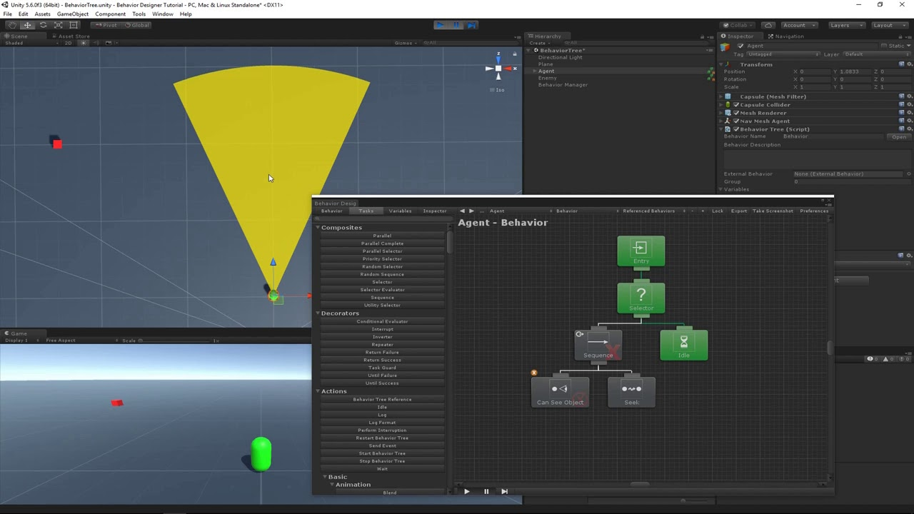
Behaviour tree
A tree of nodes (different behaviors and conditions)
Checks from the leaf nodes, find a valid path to the root node, then execute the sequence of behavior
Notes:
Quite common in video games where developers could figure out all common actions and possibilities

Slide 7
Action Lists

Slide 8
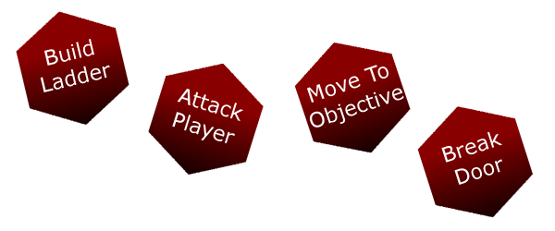
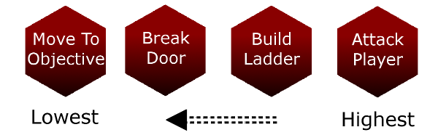
What is an action list?
Proposed by Jesse Crafts-Finch
An ordered list of possible behaviors
Simple priority queue
Additional functionality
https://www.gorillatactics.com/published-material/action-lists/

Slide 9
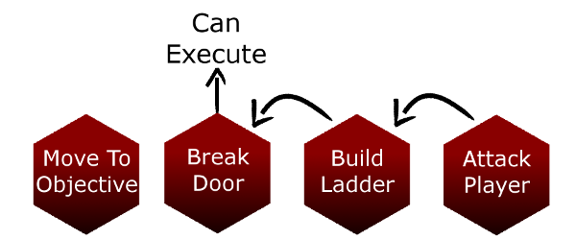
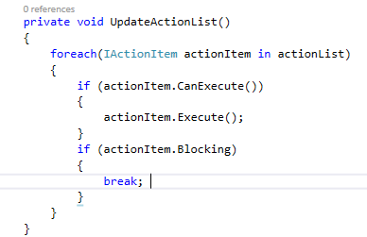
-
https://www.gorillatactics.com/published-material/action-lists/

Slide 10
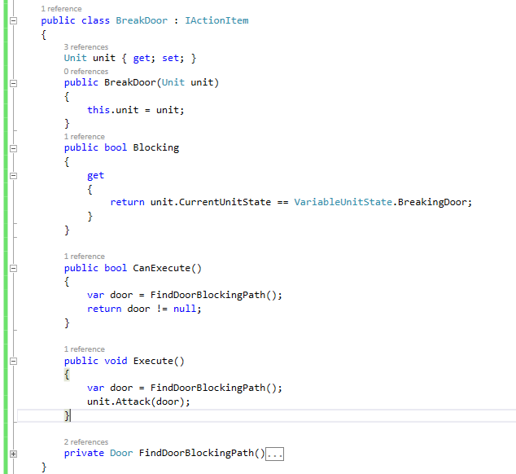
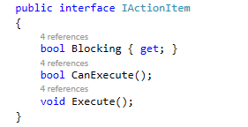
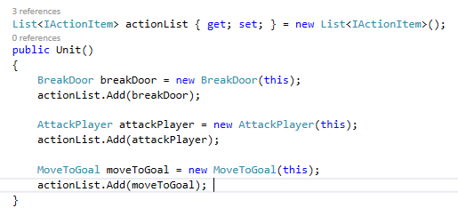
https://www.gorillatactics.com/published-material/action-lists/
Notes:
Skip over

Slide 11
Mecanim State Machine
Notes:
Jason showed how to make animations; Mecanim state machine is used to connect these animations and determine which one to play at any given moment

Slide 12
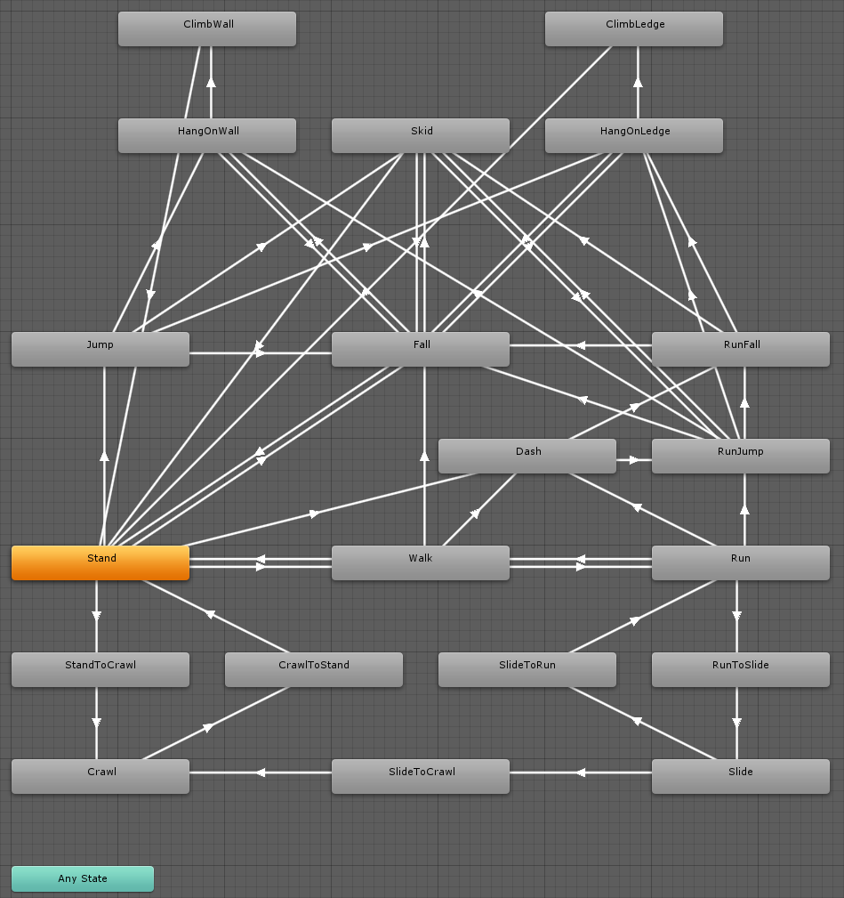
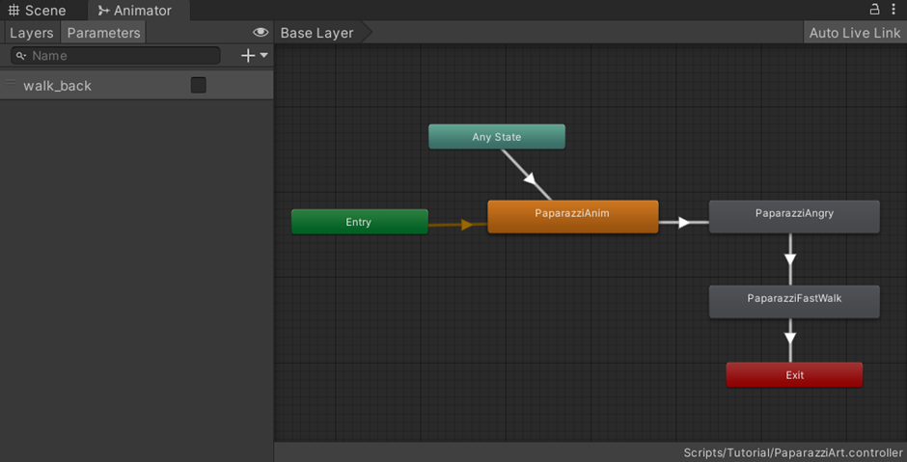

Slide 13
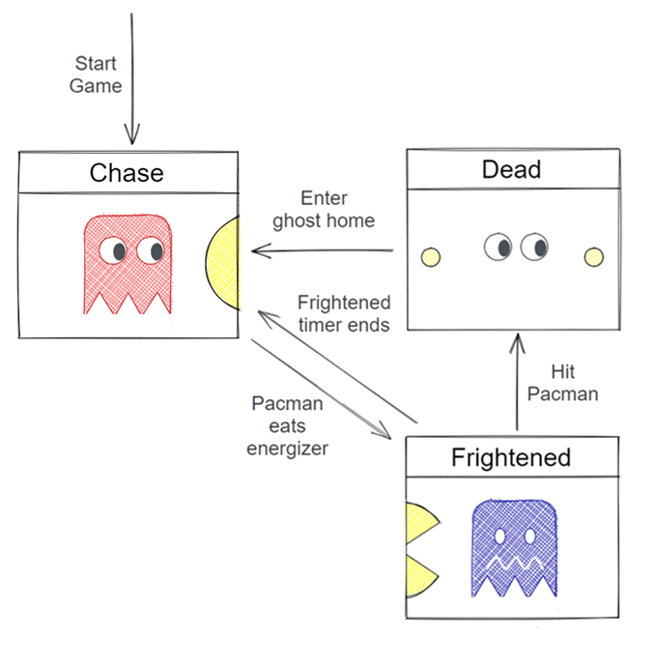
State Machine?
A state can be:
the animation played (idle, walk, jump, land)
behavior of a NPC (can be goal oriented: find target, gather materials)
which part of script is being executed
An object can occupy one state at a time
When a condition is met, transition to another state

Slide 14
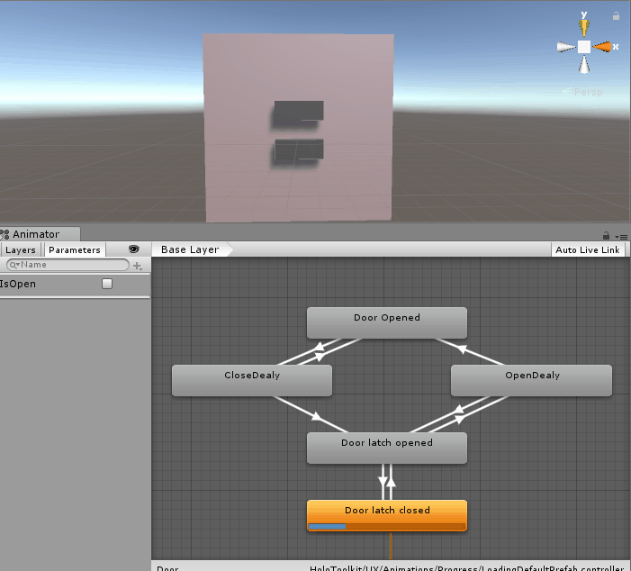
Mecanim State Machine
Unity’s built-in system to control animations
Repurpose as a generic finite state machine
Notes:
Visually like a flow-chart

Slide 15
State Machine Refresher
Skip to State Machine Behaviour
Notes:
Skip over during presentation: for students to look over after class

Slide 16
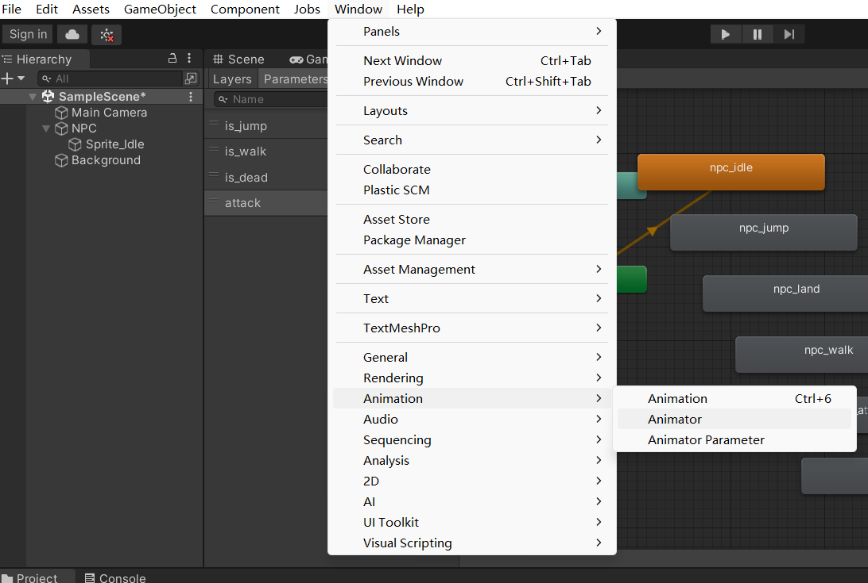
Window -> Animation -> Animation

Slide 17
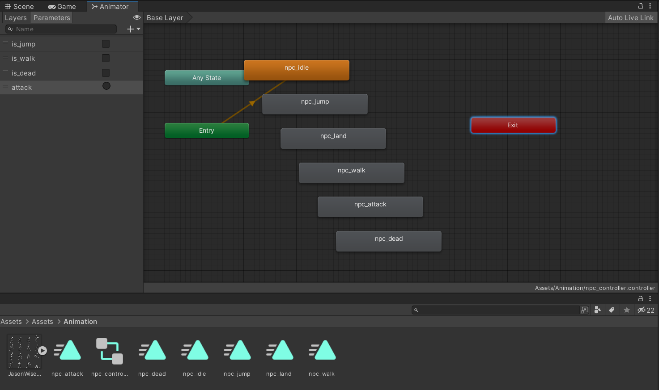

Slide 18
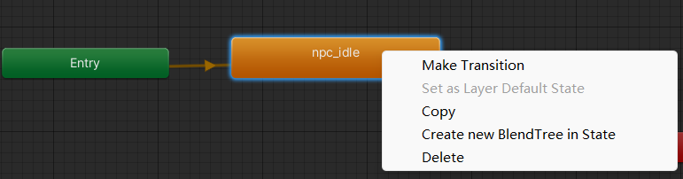
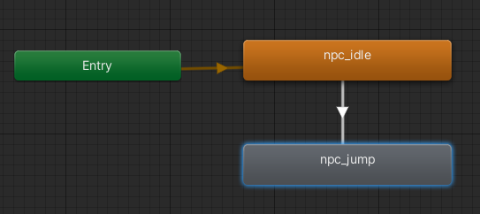

Slide 19
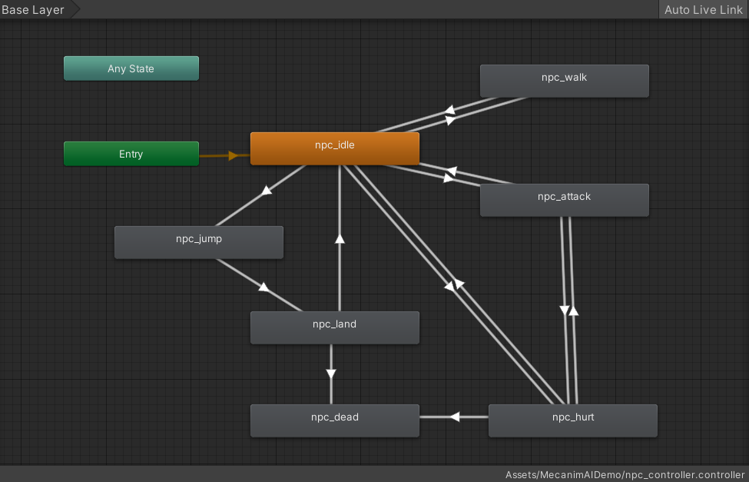
Add transitions between different states as needed
NPC cannot transition from jump to idle without going through land
No transitions from npc_dead (unless they can be revived)

Slide 20
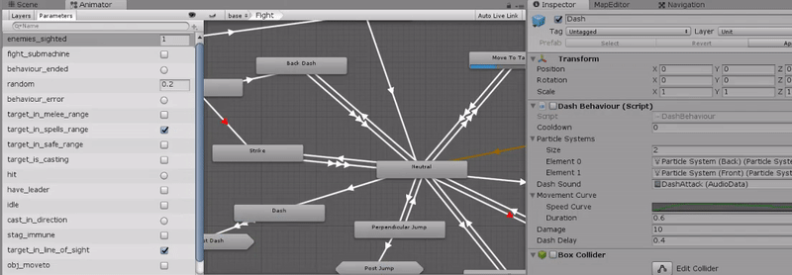

Slide 21
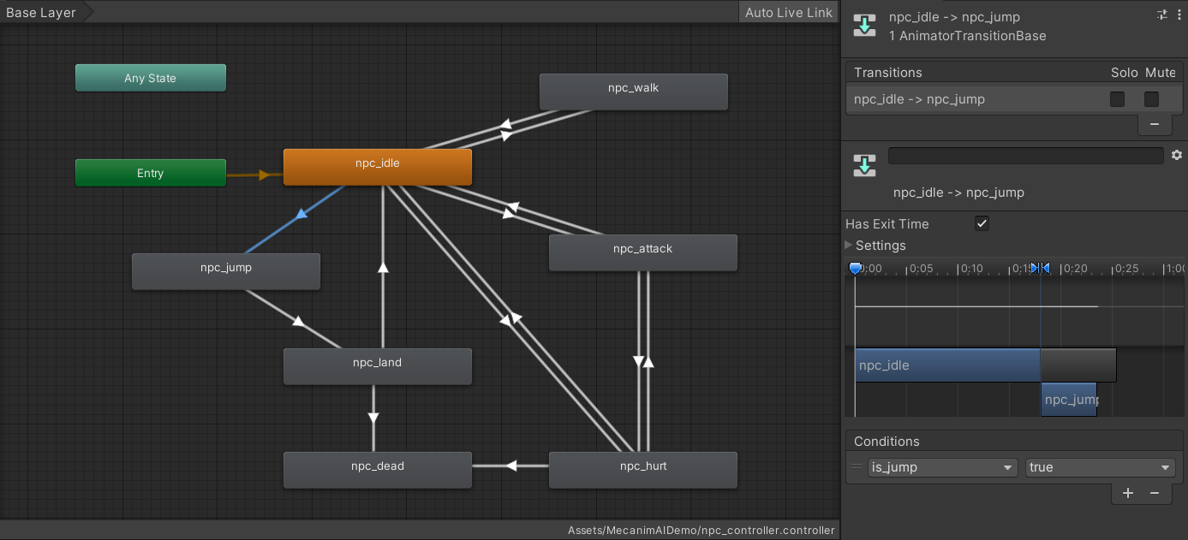

Slide 22
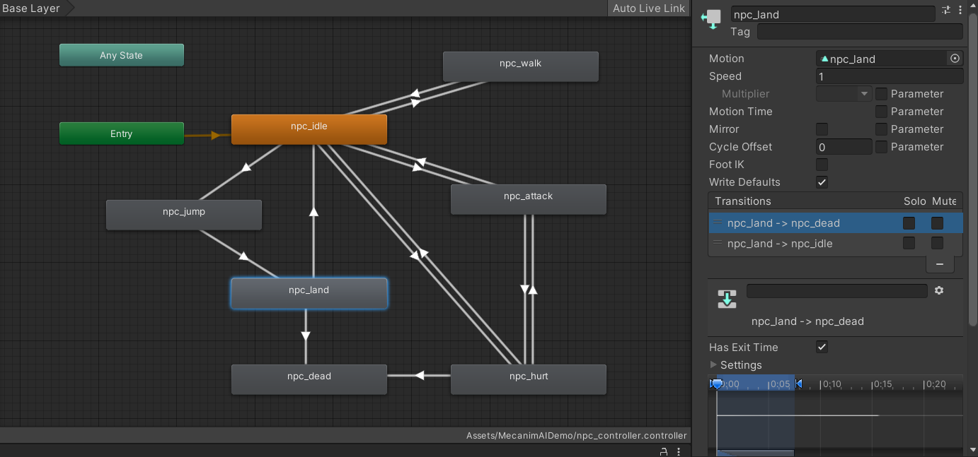
Order your transitions!
Npc_land prioritizes dead over npc_idle

Slide 23
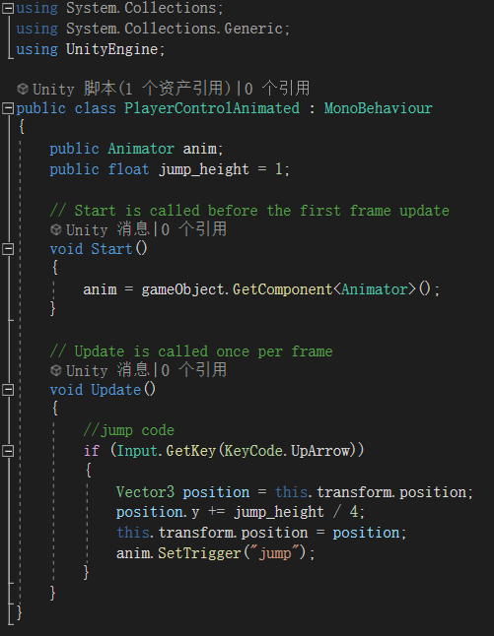
animator_name.SetBool("name_of_condition", true);
animator_name.SetFloat("name_of_condition", 1.5);
animator_name.SetTrigger("name_of_condition");

Slide 24
Scripting through states:
State Machine Behaviour

Slide 25
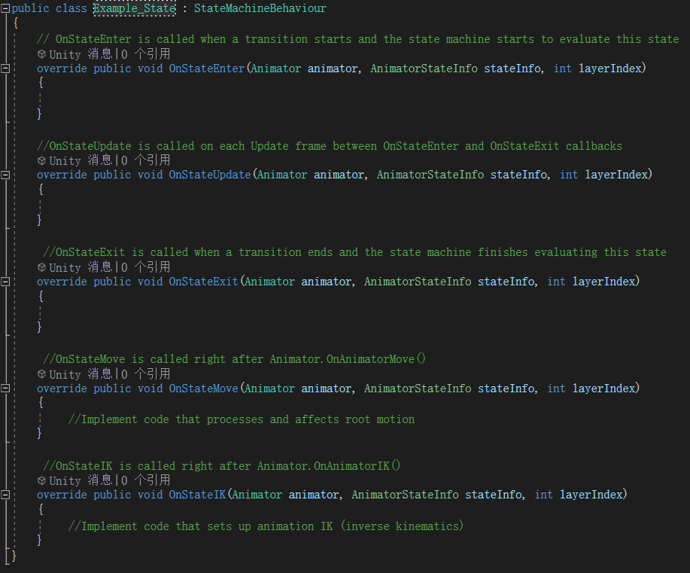
State Machine Behaviours Class
A component that can be added to any state in a state machine
Functions that automatically get called
OnStateEnter
OnStateExit
OnStateUpdate
etc.
Unity - Scripting API: StateMachineBehaviour (unity3d.com)
Notes:
Draw a parallel between OnStateEnter, OnCollisionEnter, and Start.

Slide 26
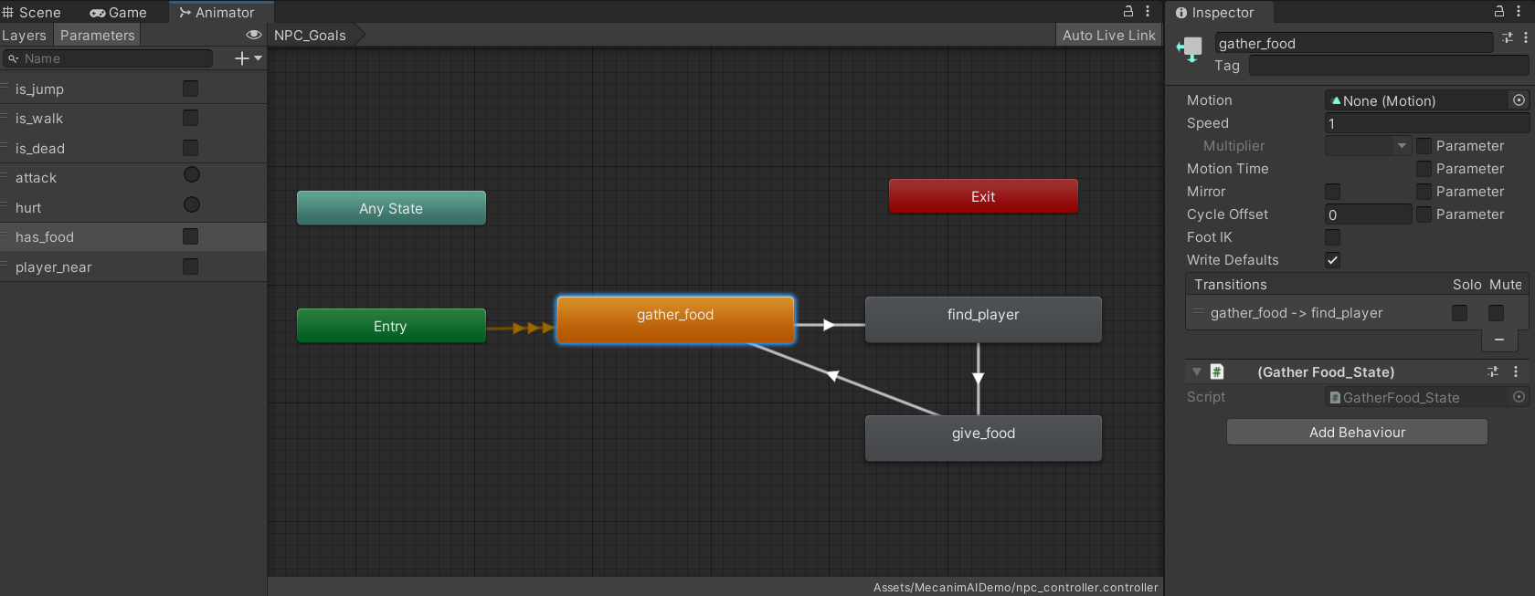
Short demo!
Download and unzip package from course website → week 6 → TA presentation

Slide 27
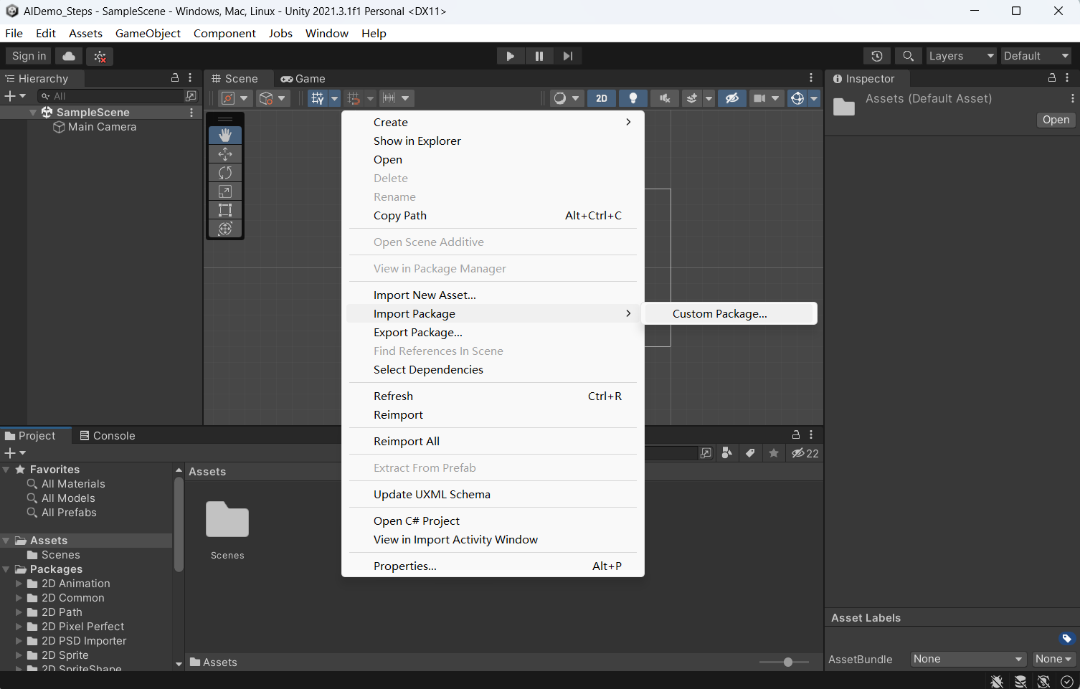
Right click on Project Assets
Import Package -> Custom Package

Slide 28
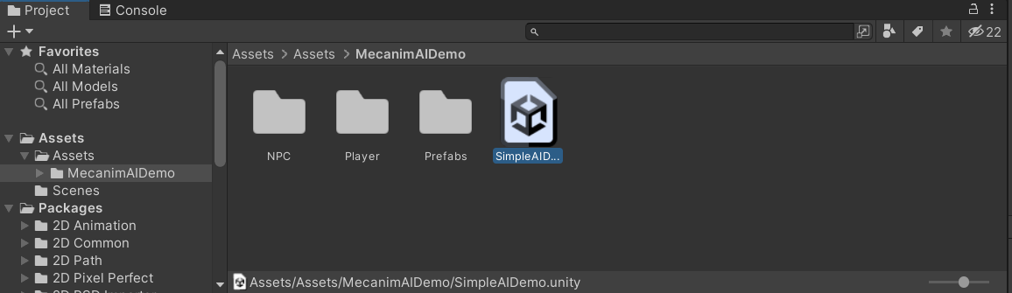
Assets > MecanimAIDemo > SimpleAIDemo scene

Slide 29
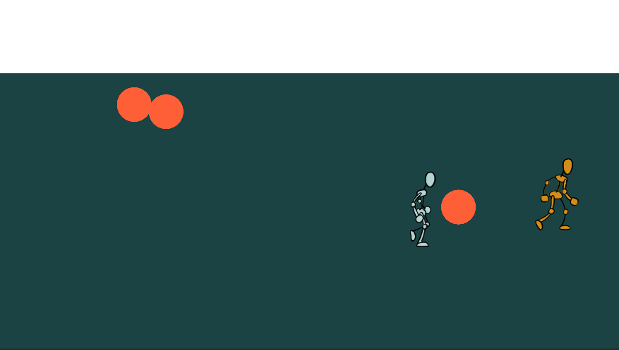
Notes:
The orange character is the player, the other one is the AI. Play around and see what happens

Slide 30
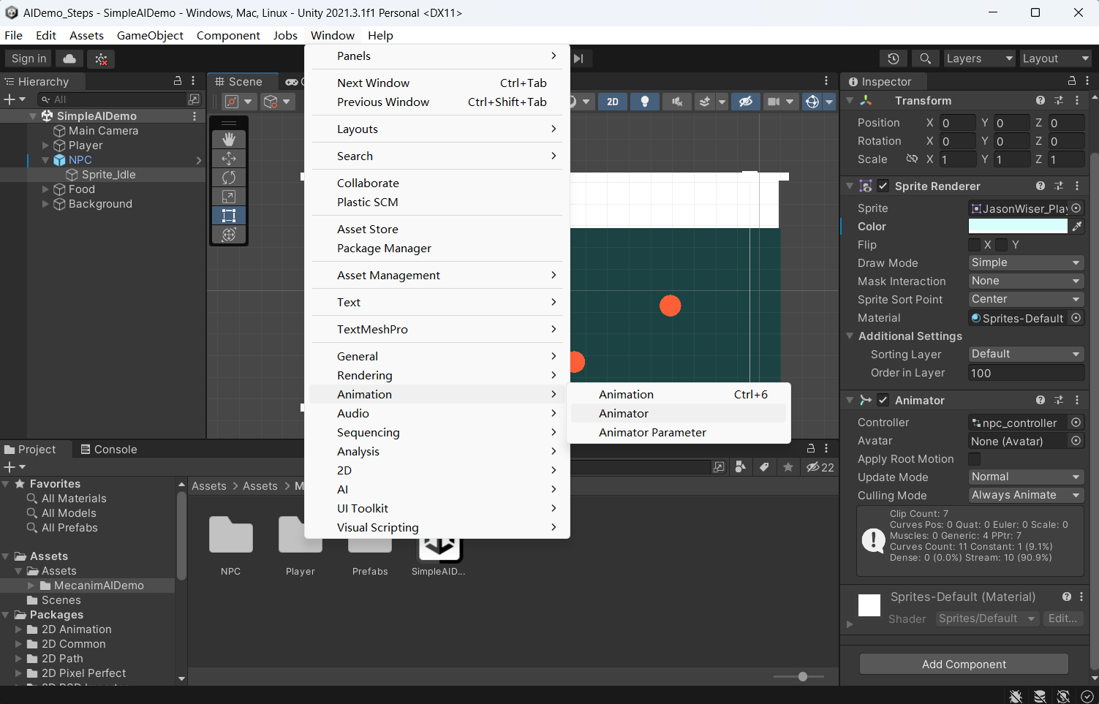
Let’s take a look at the state machine controlling the NPC
Select NPC -> Sprite_Idle
Window -> Animation -> Animator
Select Layer “NPC_Goals”

Slide 31
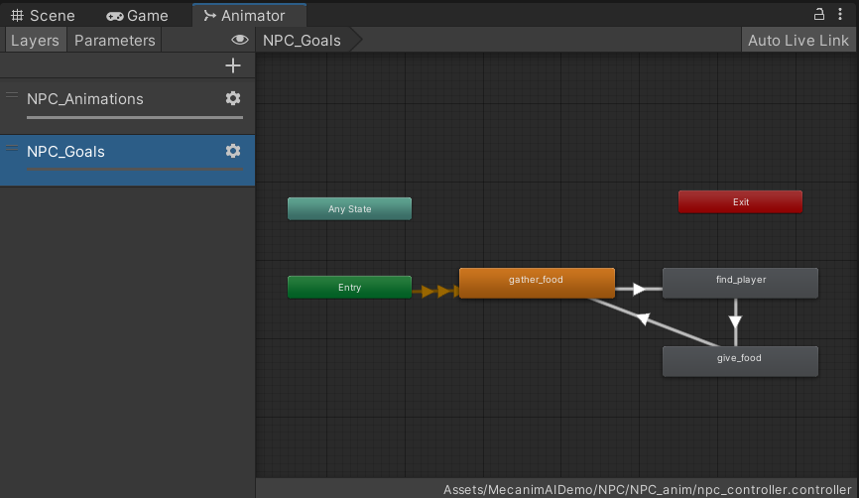
Select Layers -> NPC_Goals

Slide 32
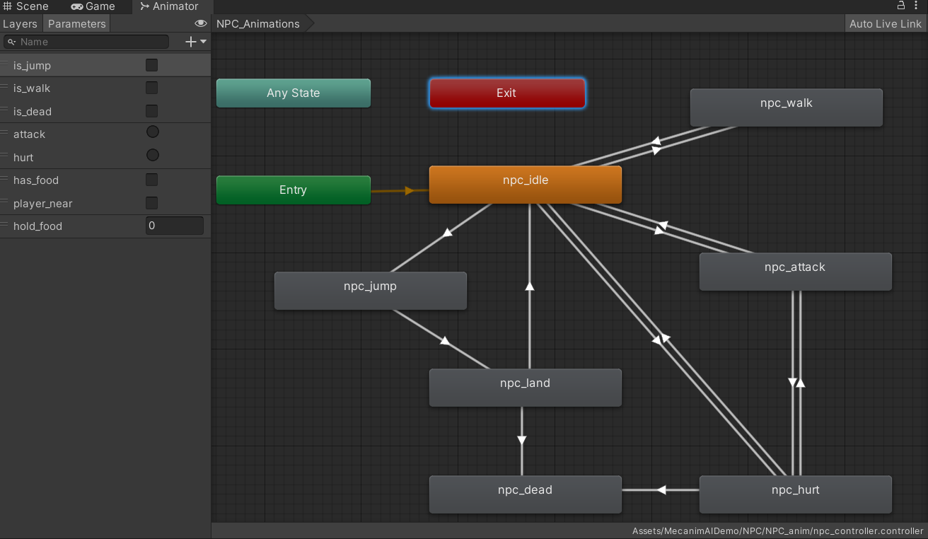
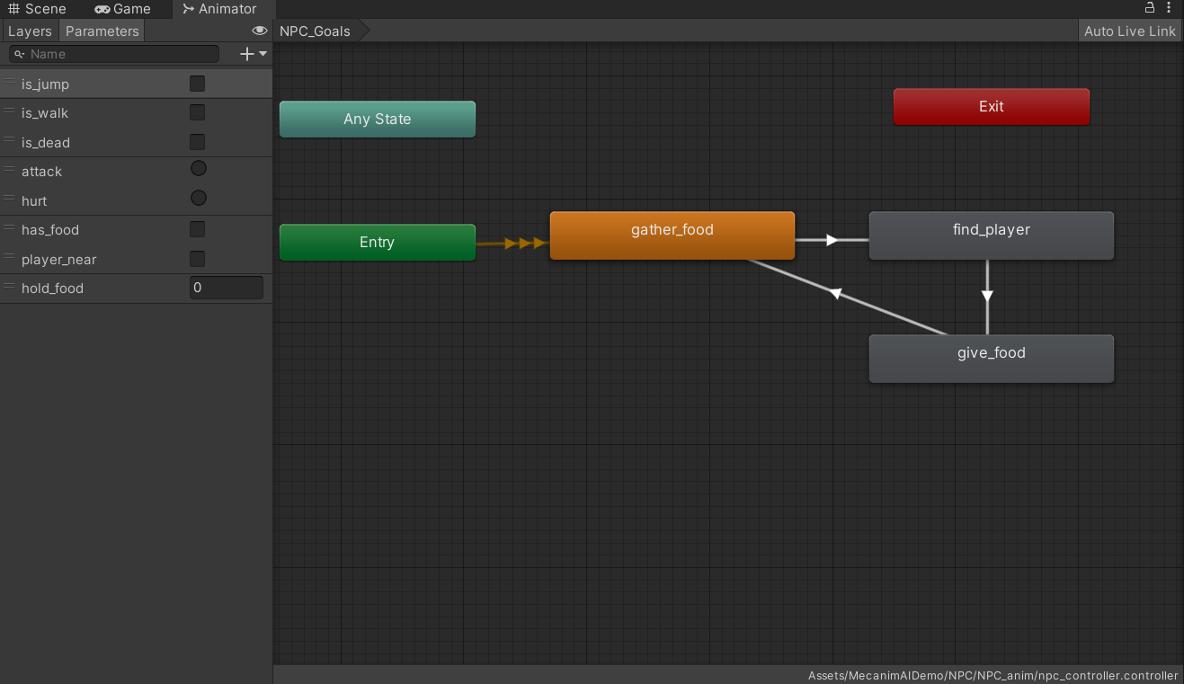
Two layers that share parameters, but are separate otherwise
NPC_Animations layer controls what animation is played
Idle, walk, attack, etc.
NPC_Goals controls which behavior script is executed
Gather food, find player, give food
You could also just have one state machine to control both animation and goals!

Slide 33
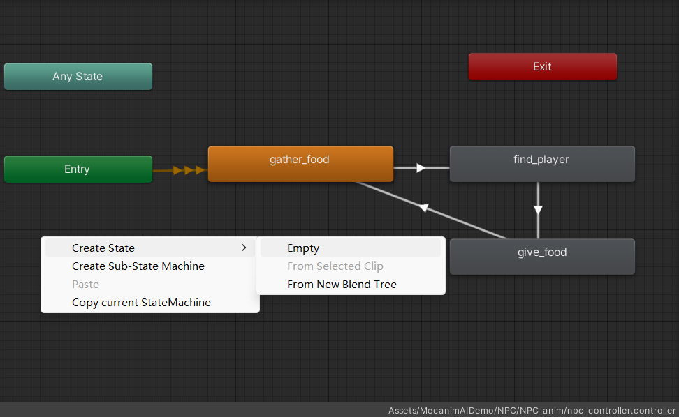
Right click on empty space -> Create State -> Empty

Slide 34
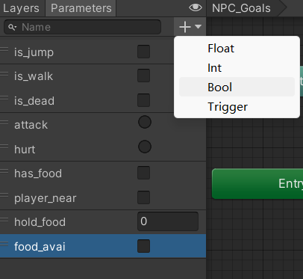
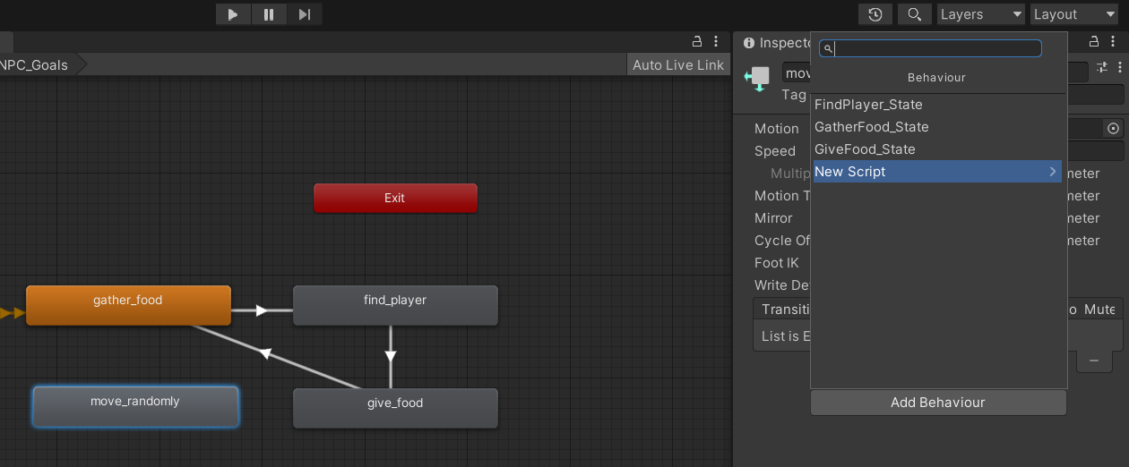
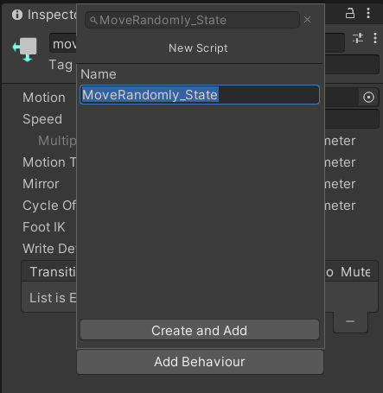
Create a new bool parameter food_avai
Add Behaviour to the move_randomly state
New Script: MoveRandomly_State

Slide 35
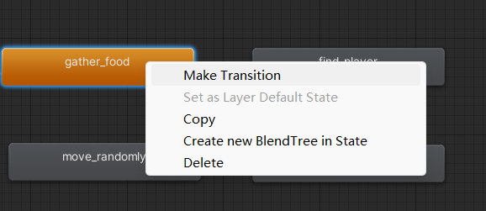
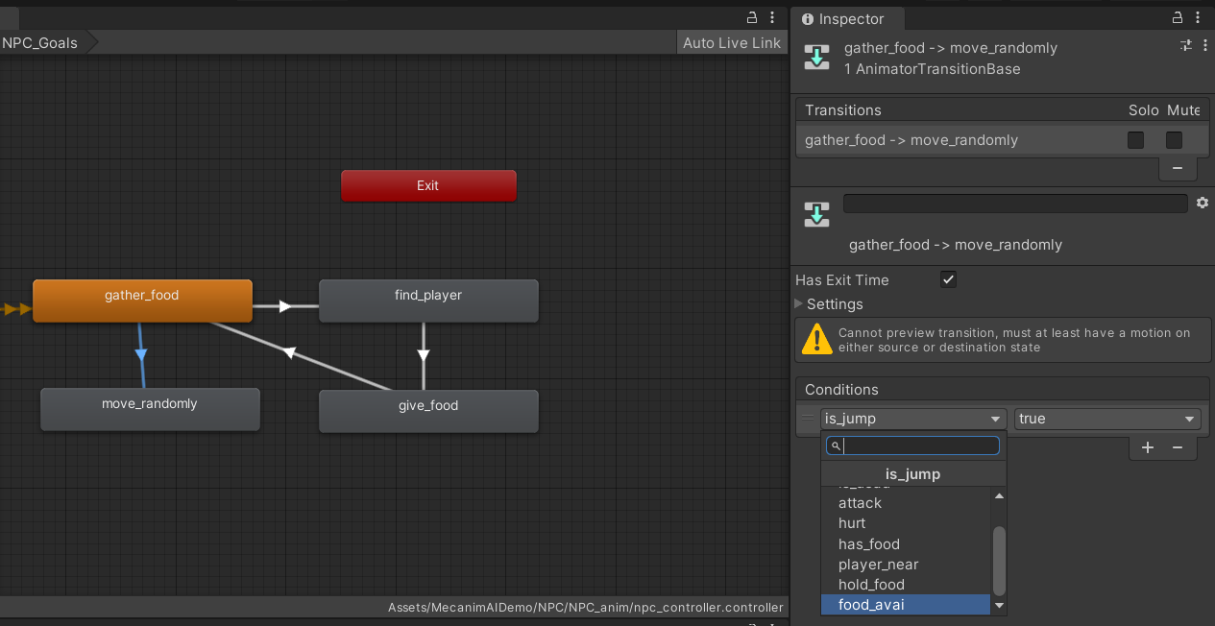
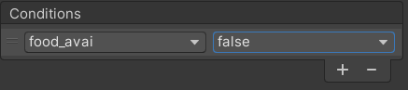
Create a new transition from gather_food to move_randomly
Condition: food_avai = false
The reverse transition has the opposite condition value (move_randomly -> gather_food, food_avai = true)

Slide 36
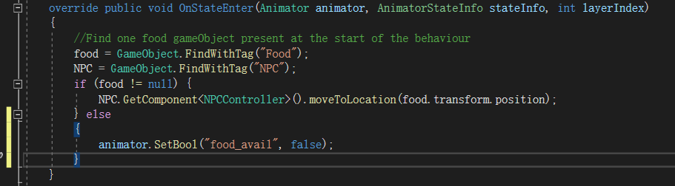
GatherFood_State script
Add line to set food_avai to false

Slide 37
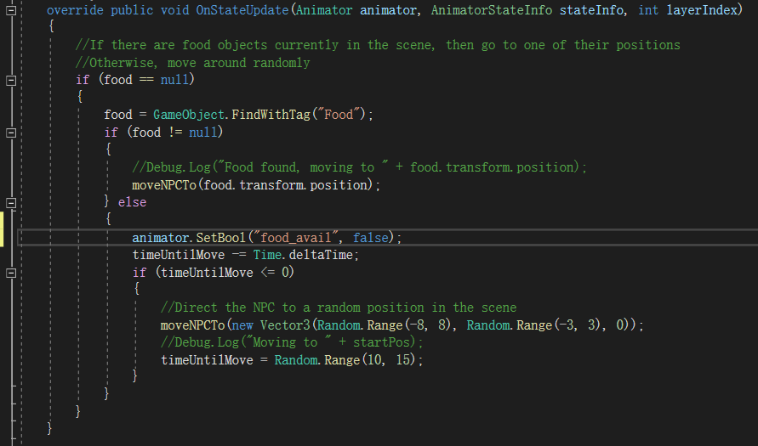
GatherFood_State script
Add
Copy and paste into MoveRandomly_State

Slide 38
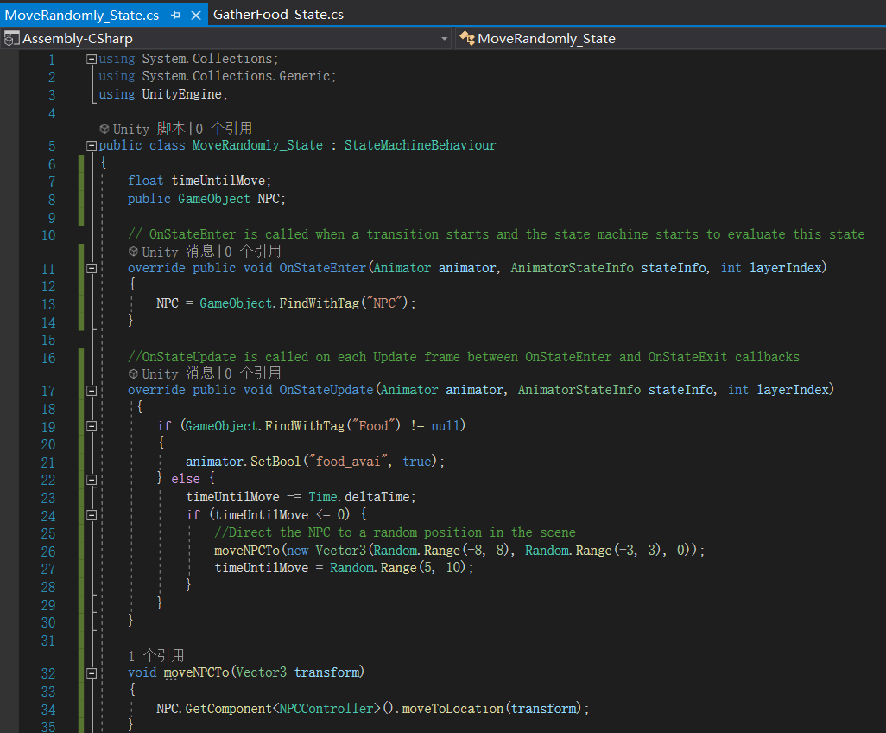
MoveRandomly_State Script
Tell the NPC Controller to start moving to a random location, after a random amount of time

Slide 39
Data flow diagram
Player input, collider detection, etc.
Controller
Public functions
State Machine Parameters
Animation 1
Animation state machine
Animation 2
Script 1
Goal-oriented state machine
Script 2

Slide 40
Pros
Cons
Using Mecanim for AI behavior
Easy to implement complex hierarchy of priorities (multiple prerequisites for a behavior, loop, etc.)
Can connect to NavMesh for pathfinding
No need for long if-else statements
Must define all states and transitions
Difficult to debug

Slide 41
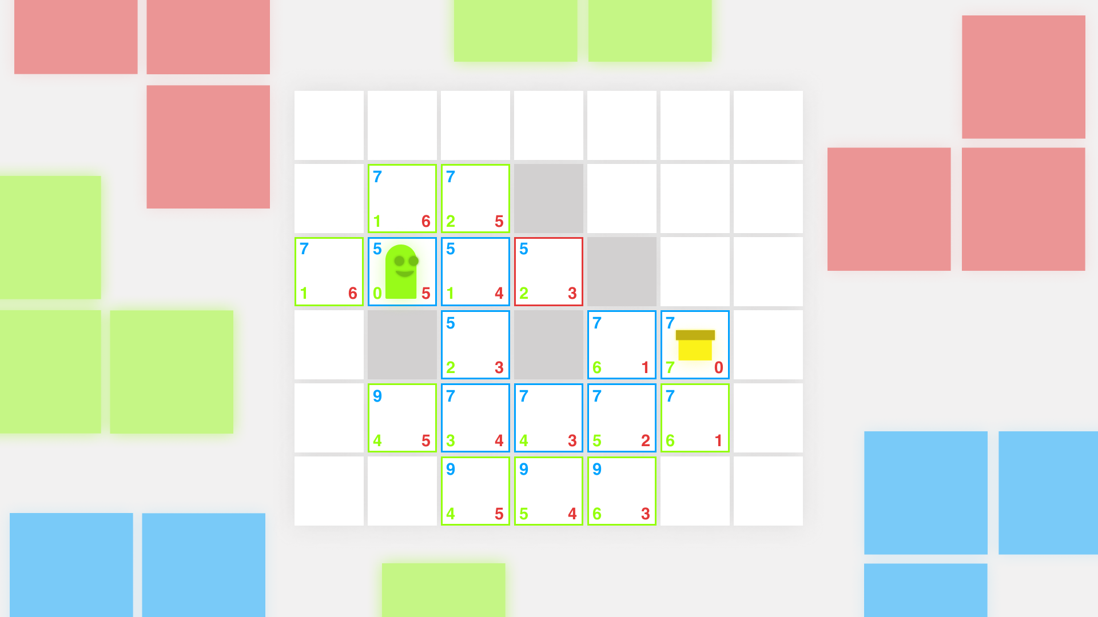
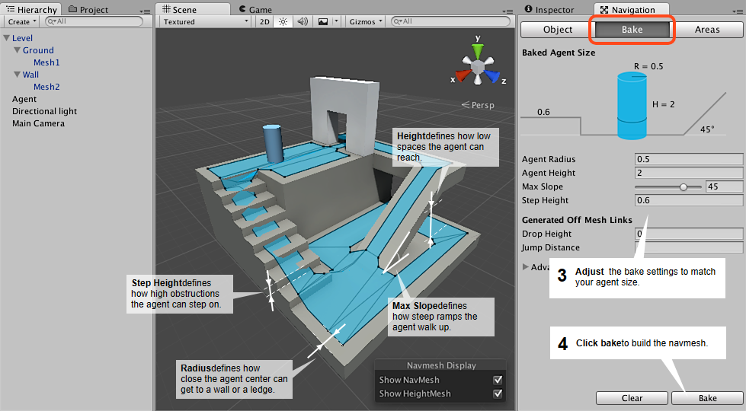
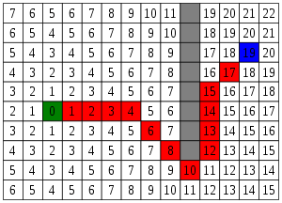
Pathfinding
A* algorithm
2D or 3D
Modified Dijkstra's algorithm
Used by Minecraft mobs
NavMesh
Only for Unity 3D projects
Unity’s built-in navigation system
https://docs.unity3d.com/Manual/nav-BuildingNavMesh.html

Slide 42
Resources
Action Lists
https://www.gorillatactics.com/published-material/action-lists/
Implementing Enemy AI behaviors
http://www.madwomb.com/tutorials/GameDesign_Unity2DAction.html#02d
Mecanim AI
https://medium.com/the-unity-developers-handbook/dont-re-invent-finite-state-machines-how-to-repurpose-unity-s-animator-7c6c421e5785
https://www.red-gate.com/simple-talk/homepage/unity-state-machine-behaviours/
https://blog.devgenius.io/state-pattern-in-unity-cd180f98c45
NavMesh (Pathfinding)
https://youtu.be/CHV1ymlw-P8
Video tutorials
https://gamedevacademy.org/best-unity-ai-tutorials/

Slide 43
Thank you for listening!

